Slide 1

MCQ QuIz game using Python and GUI
Presented by
Kavitha subramani

Slide 2

Agenda
Objective and scope
Technology
Code of the project
Summary

Slide 3

Objective:
The objective is to create a user-friendly interface that allows users to select from a set of multiple-choice questions, answer them, and receive immediate feedback on their performance. The project may also include features such as a timer, and the ability to save and resume progress. Overall, the goal is to create a fun and educational tool for individuals looking to improve their computer knowledge skills.
Scope
The scope of a simple multiple-choice Computer quiz game project using Python Tkinter and Open Trivia DB is to provide an interactive and engaging way for users to test their knowledge of computer programming concepts.

Slide 4

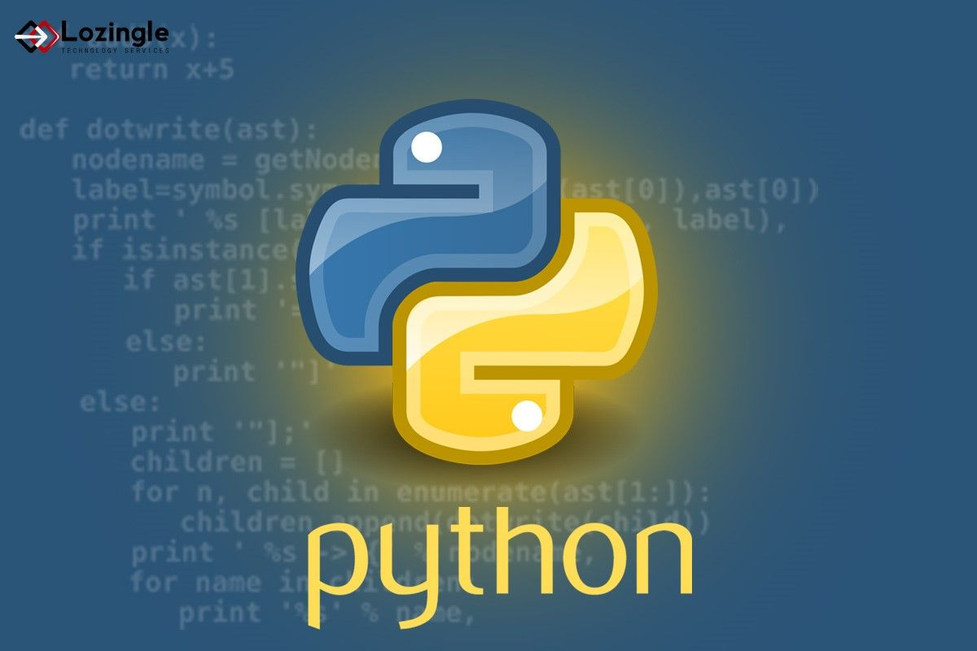
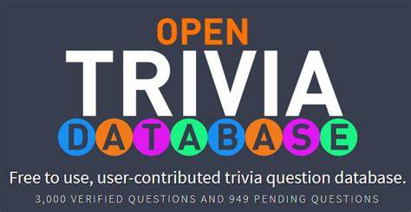


TECHNOLOGY USED

Slide 5
pseudocode
Fetch questions from the Open Trivia DB API.
Create a different object using a Question class for each fetched question.
Append all these Question objects to a question_bank list.
Create the User Interface(GUI) of the application using Tkinter.
Display the first question from the question_bank list.
Wait for the user to select an answer.
Check if the answer is correct or not.
If correct, increment the score and display the next question.
If incorrect, display the correct answer and display the next question.
At the end of the questions it displays the overall score with percent and how many correct and wrong answers
Once you close the message box the master window will destroy

Slide 6
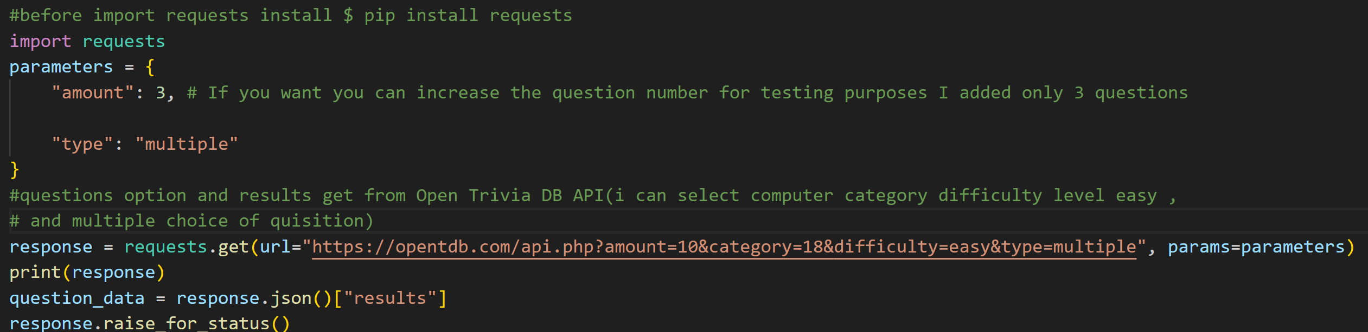
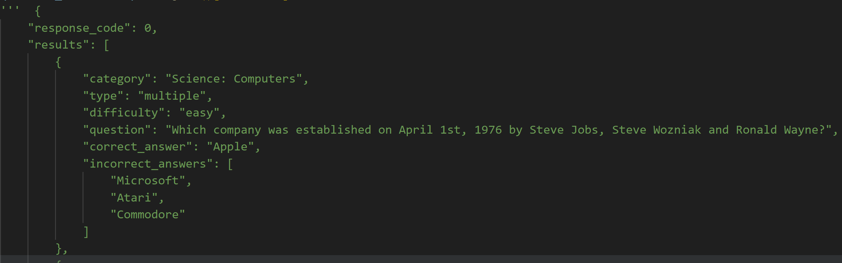
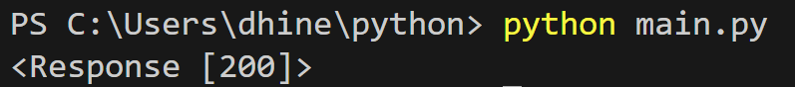
Project Code

Slide 7
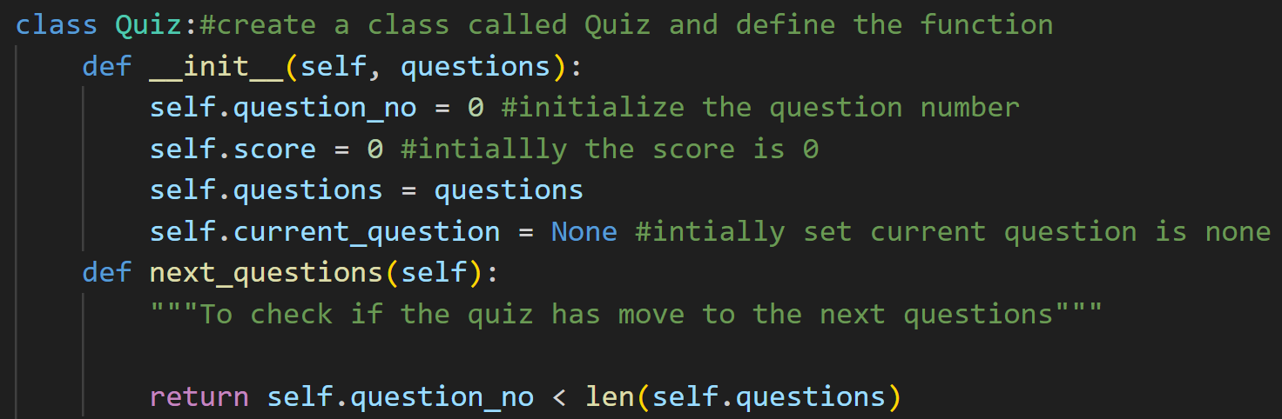
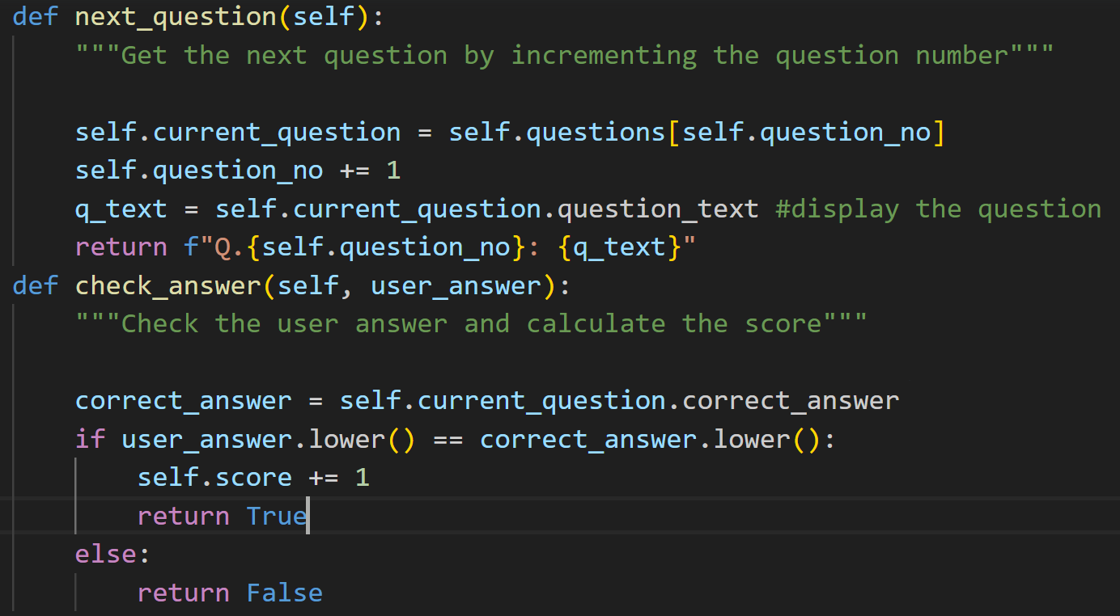
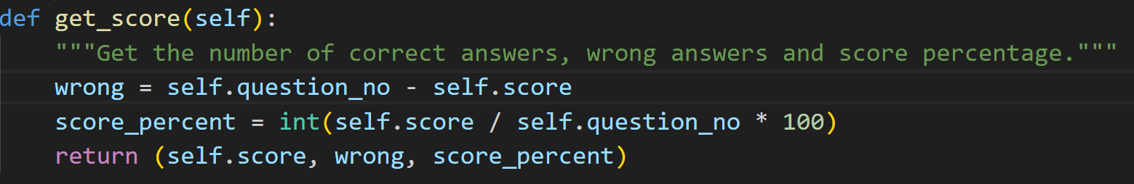

Slide 8
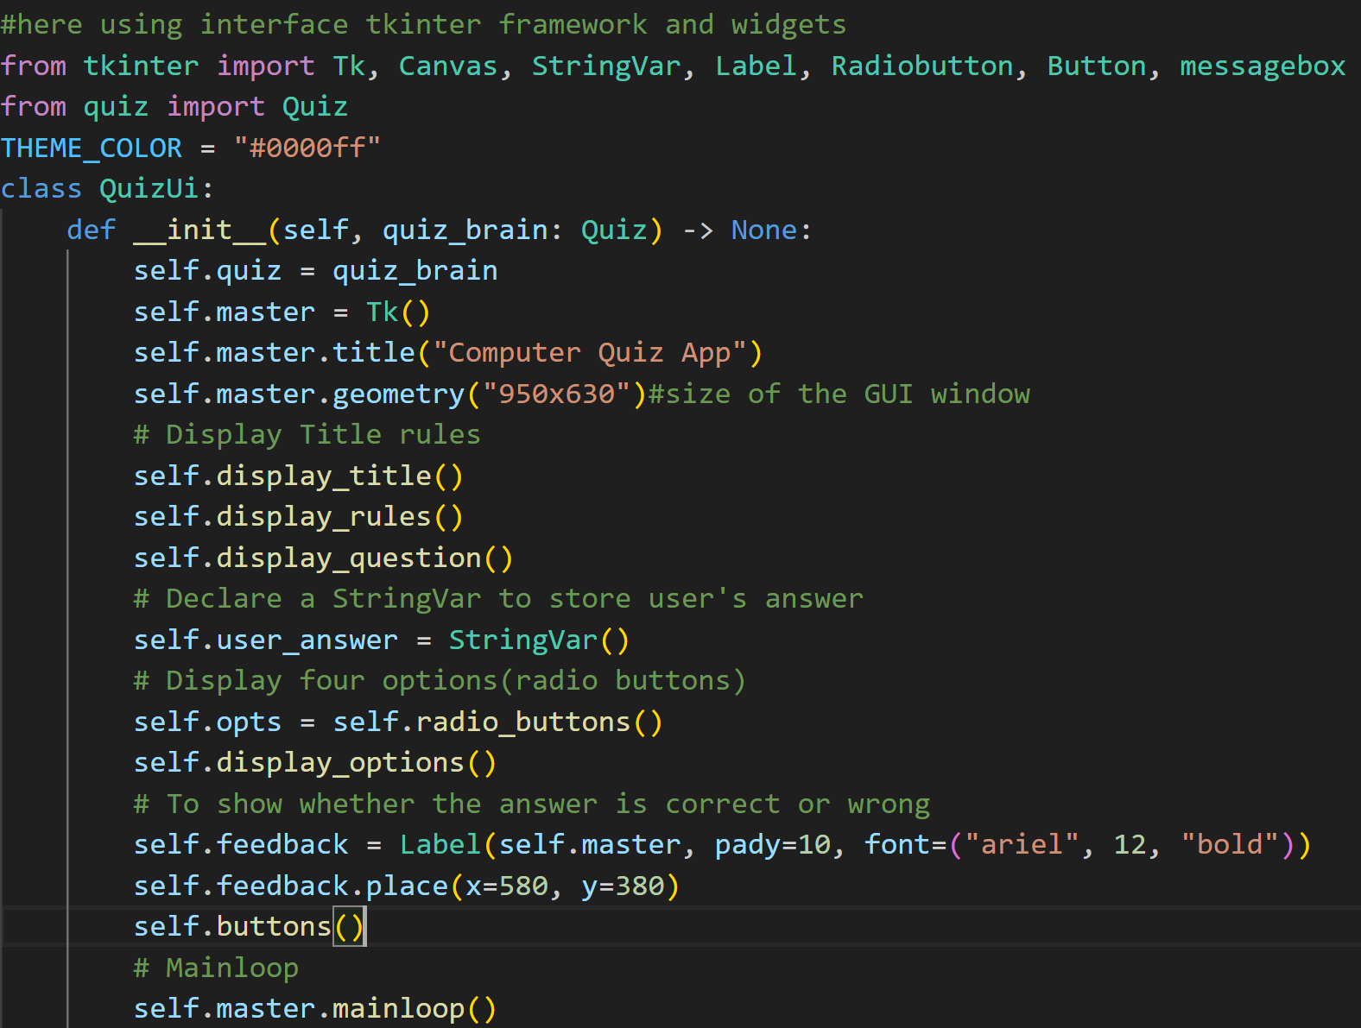
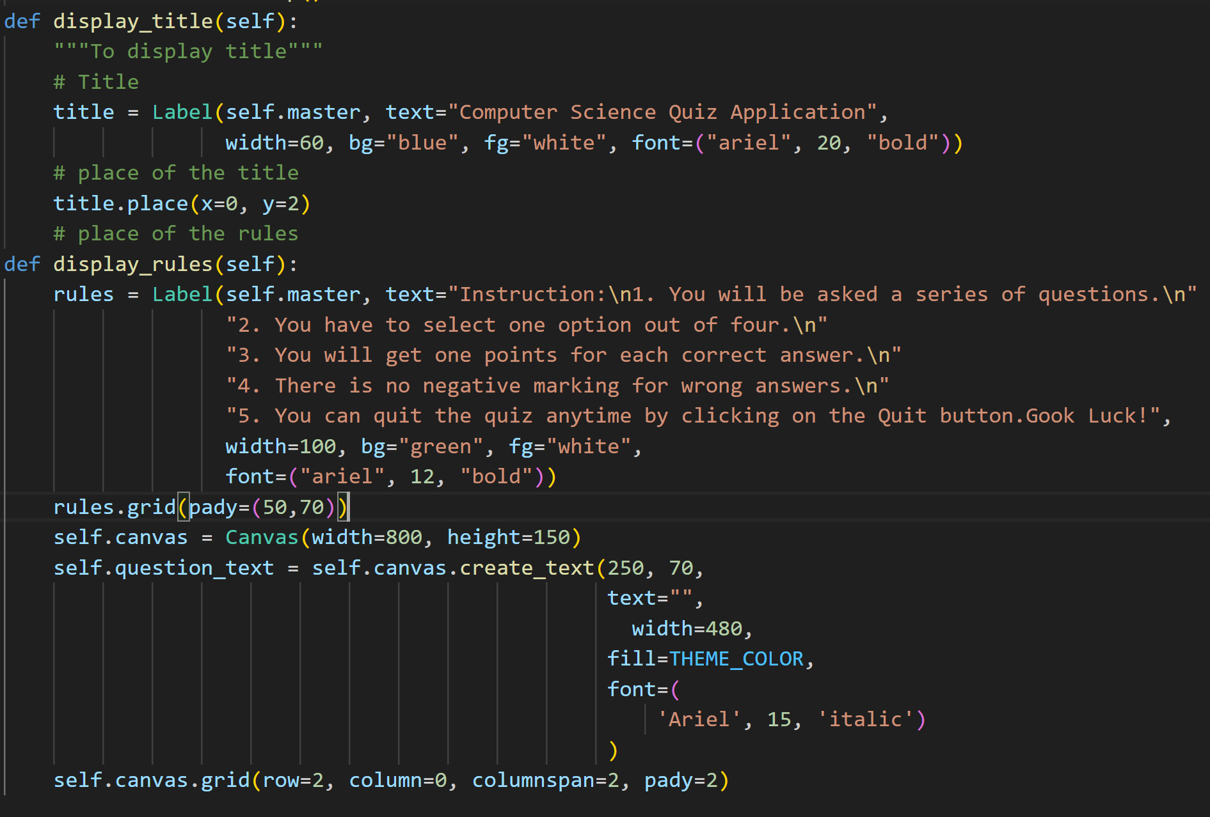

Slide 9
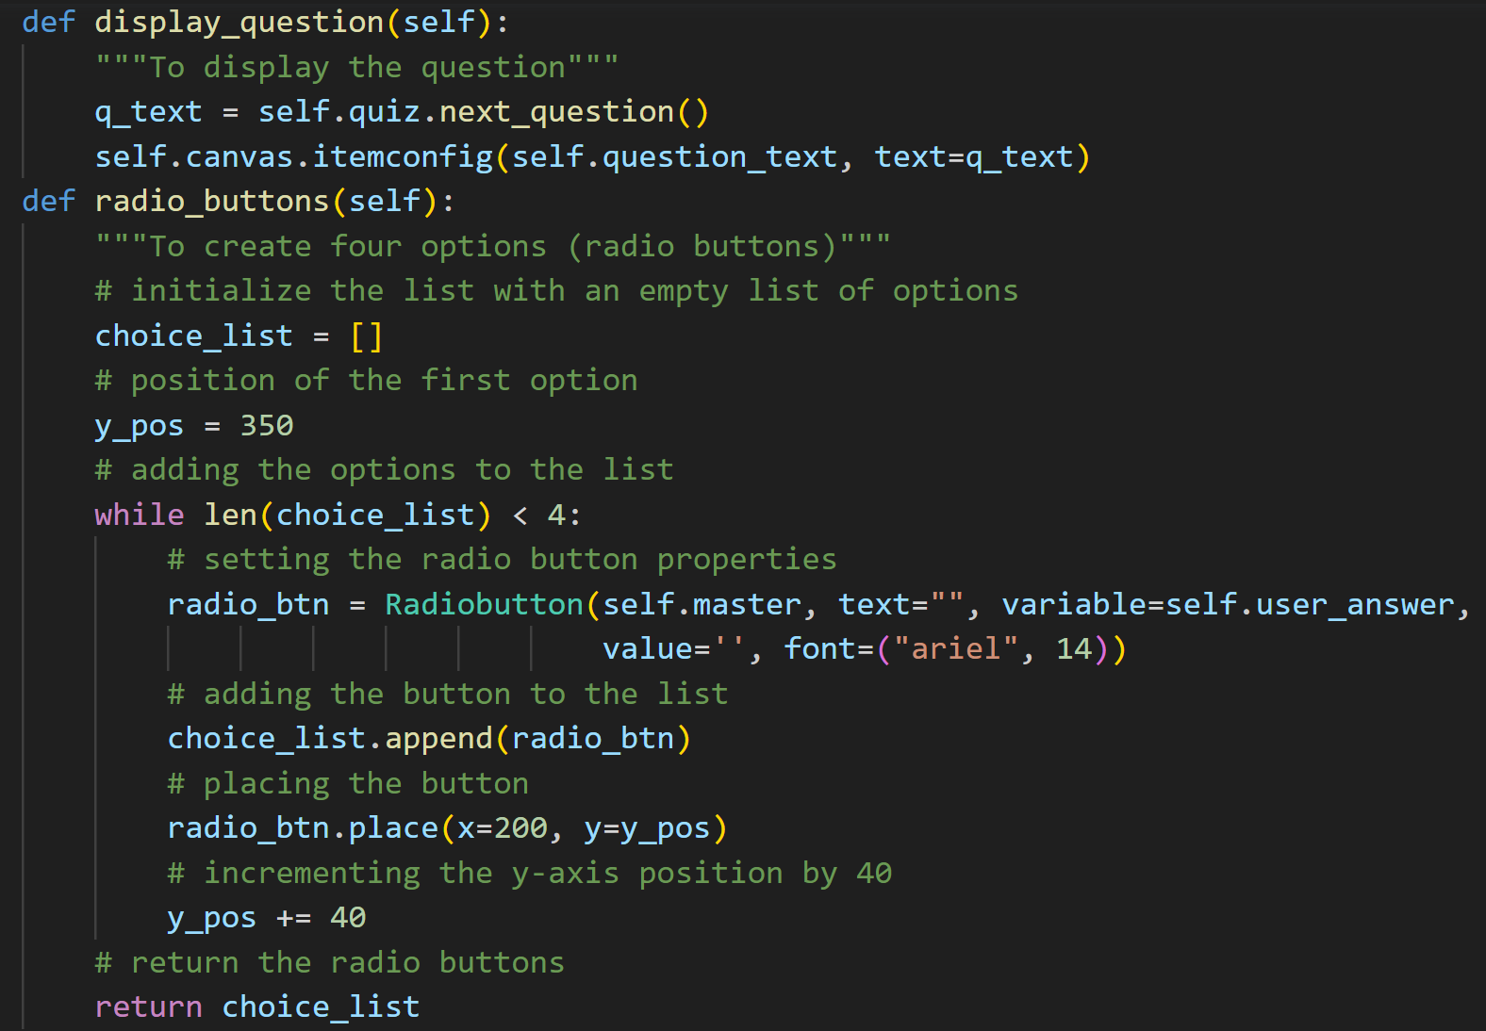
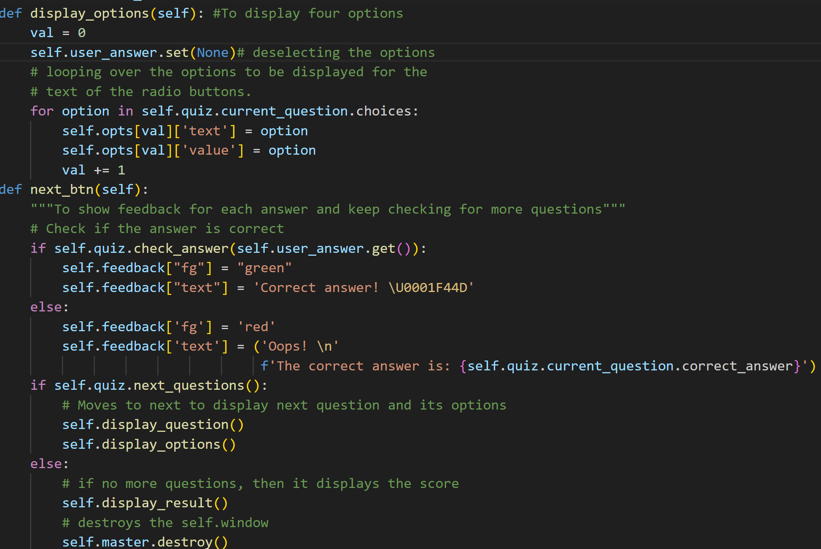

Slide 10
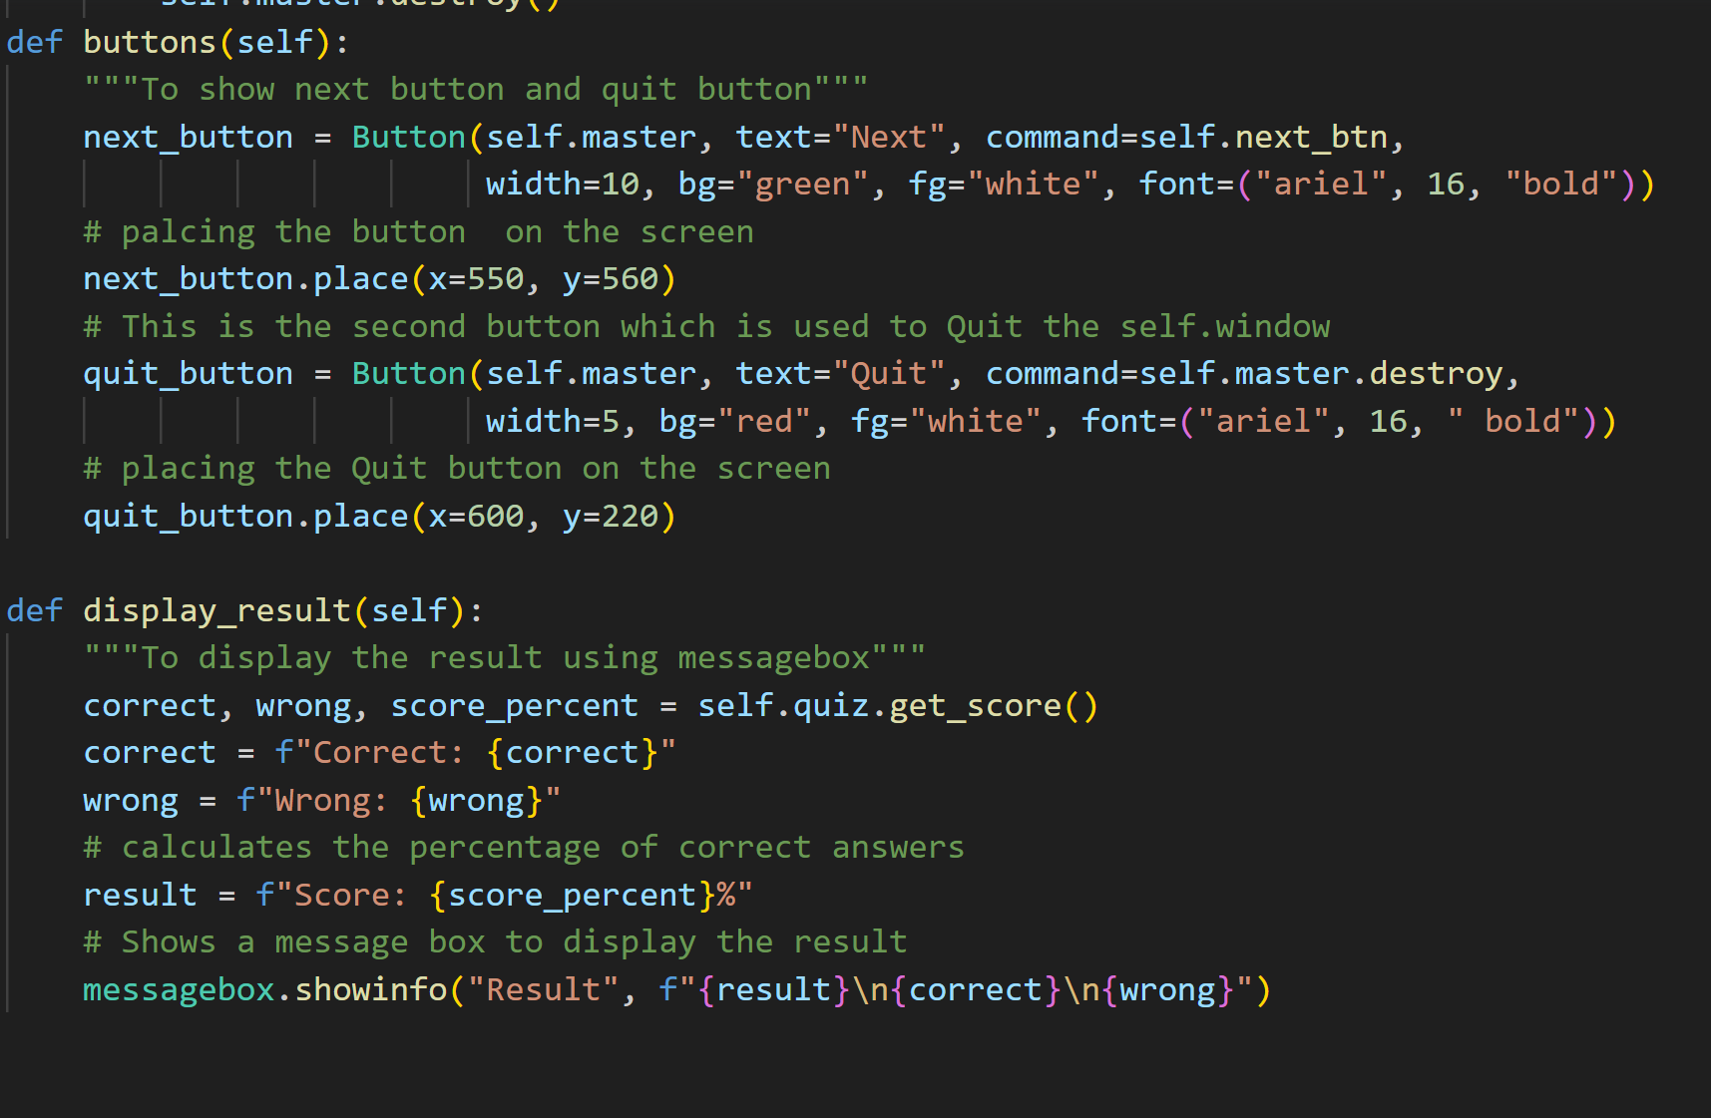
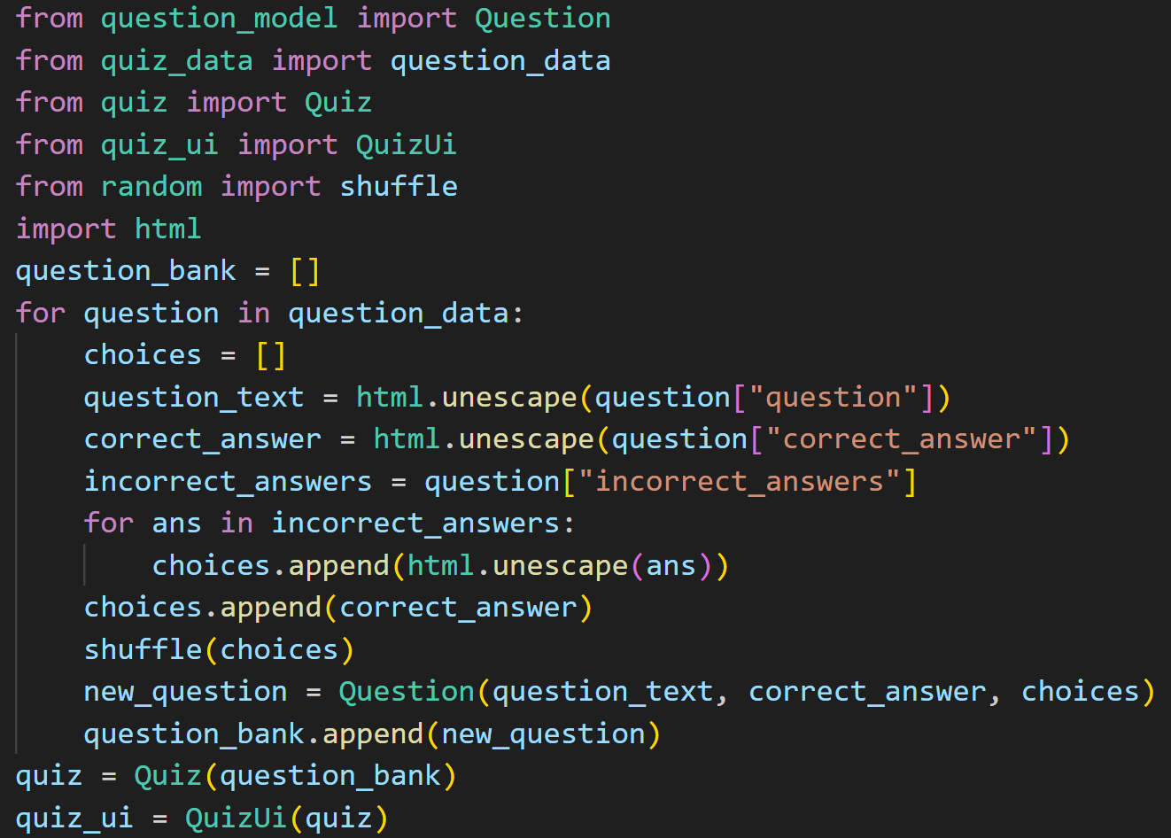

Slide 11
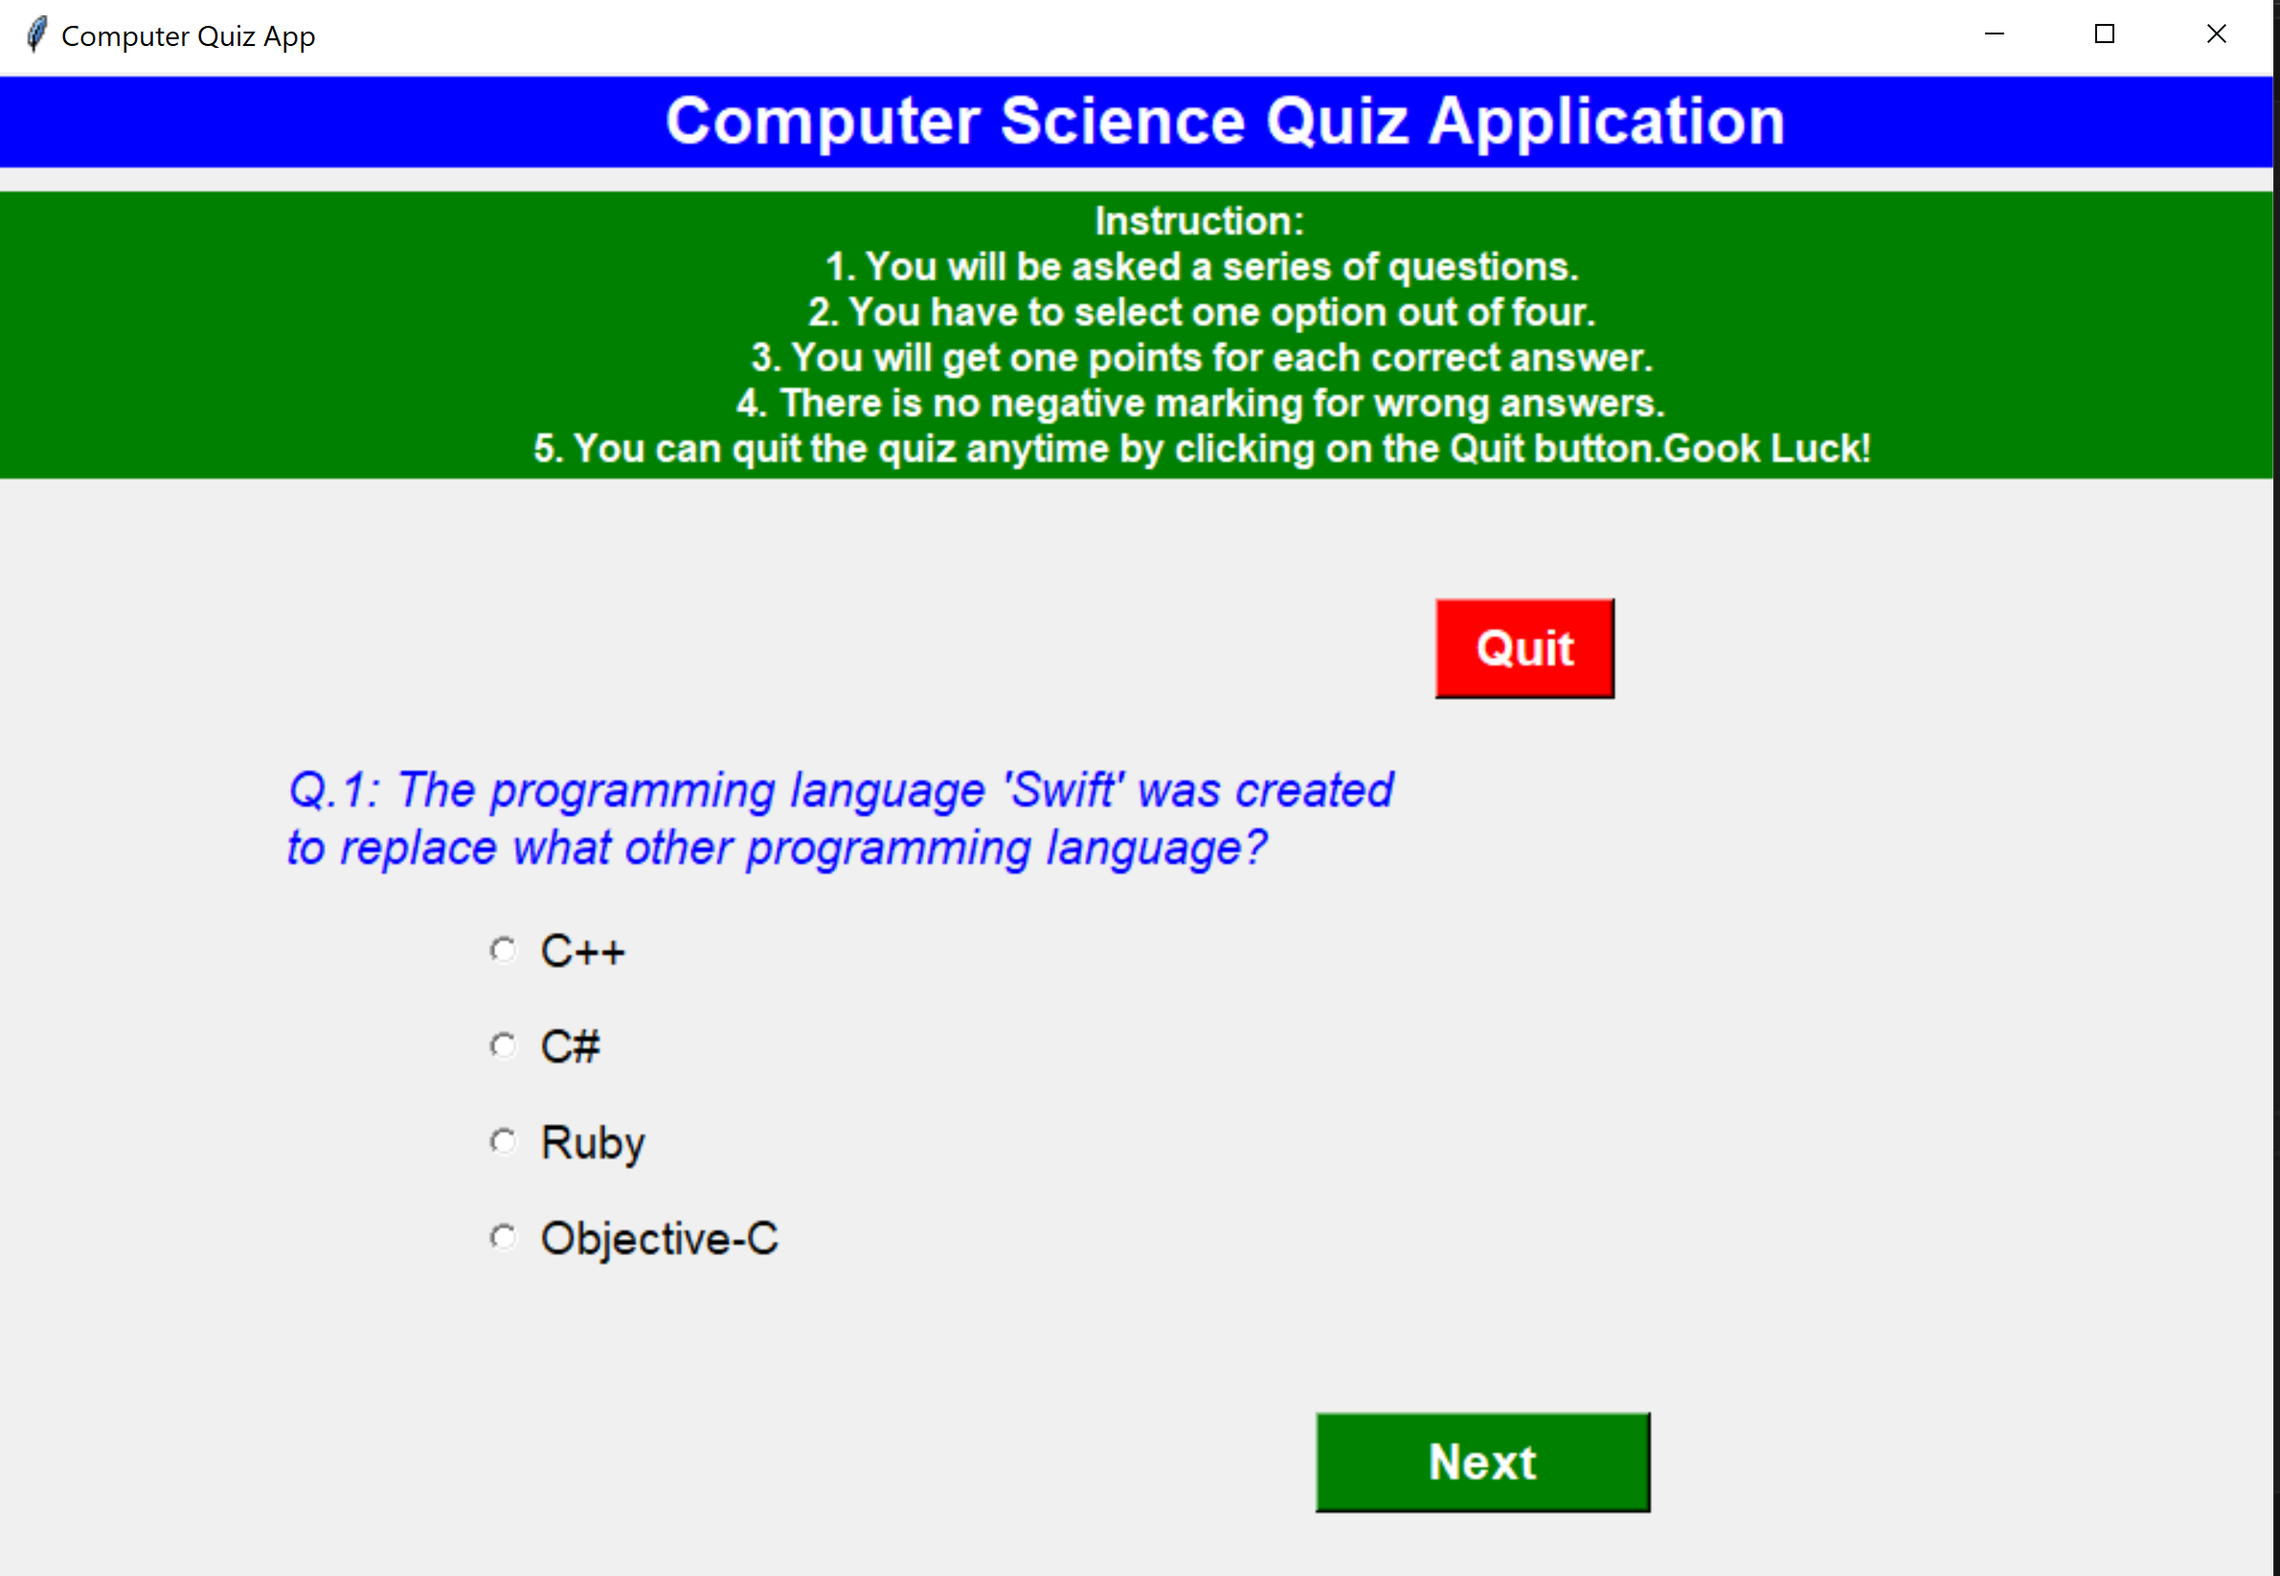
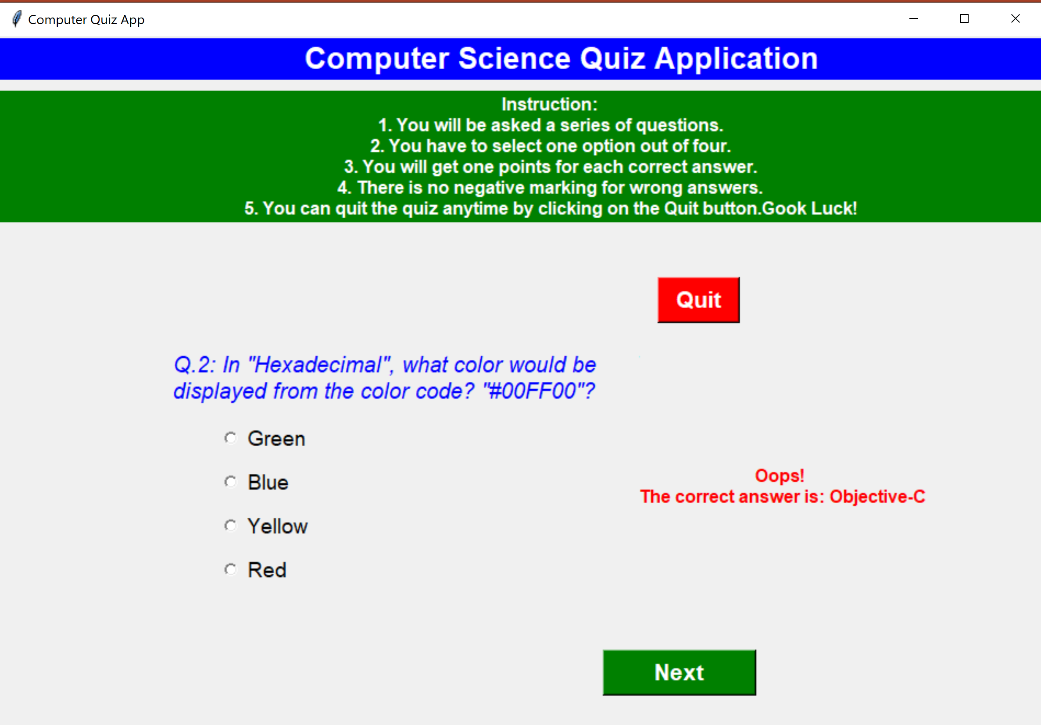
OUTPUT

Slide 12
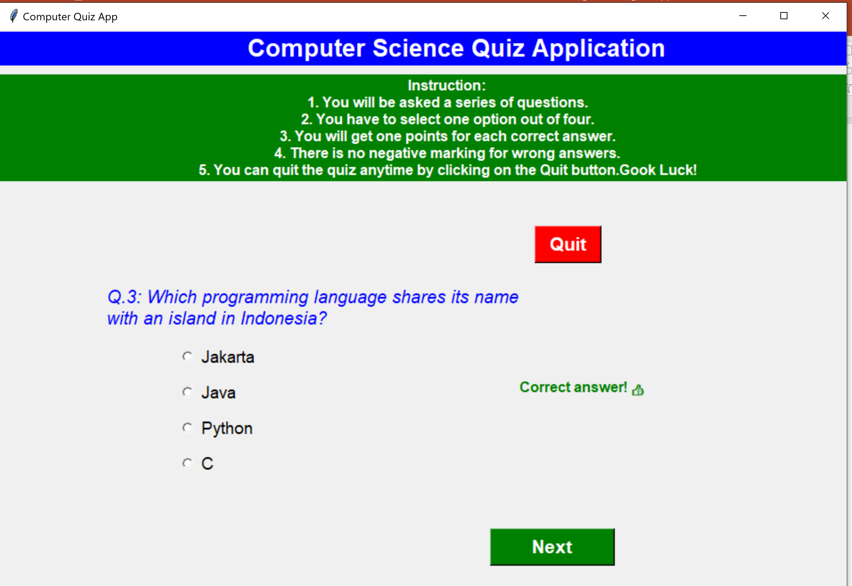
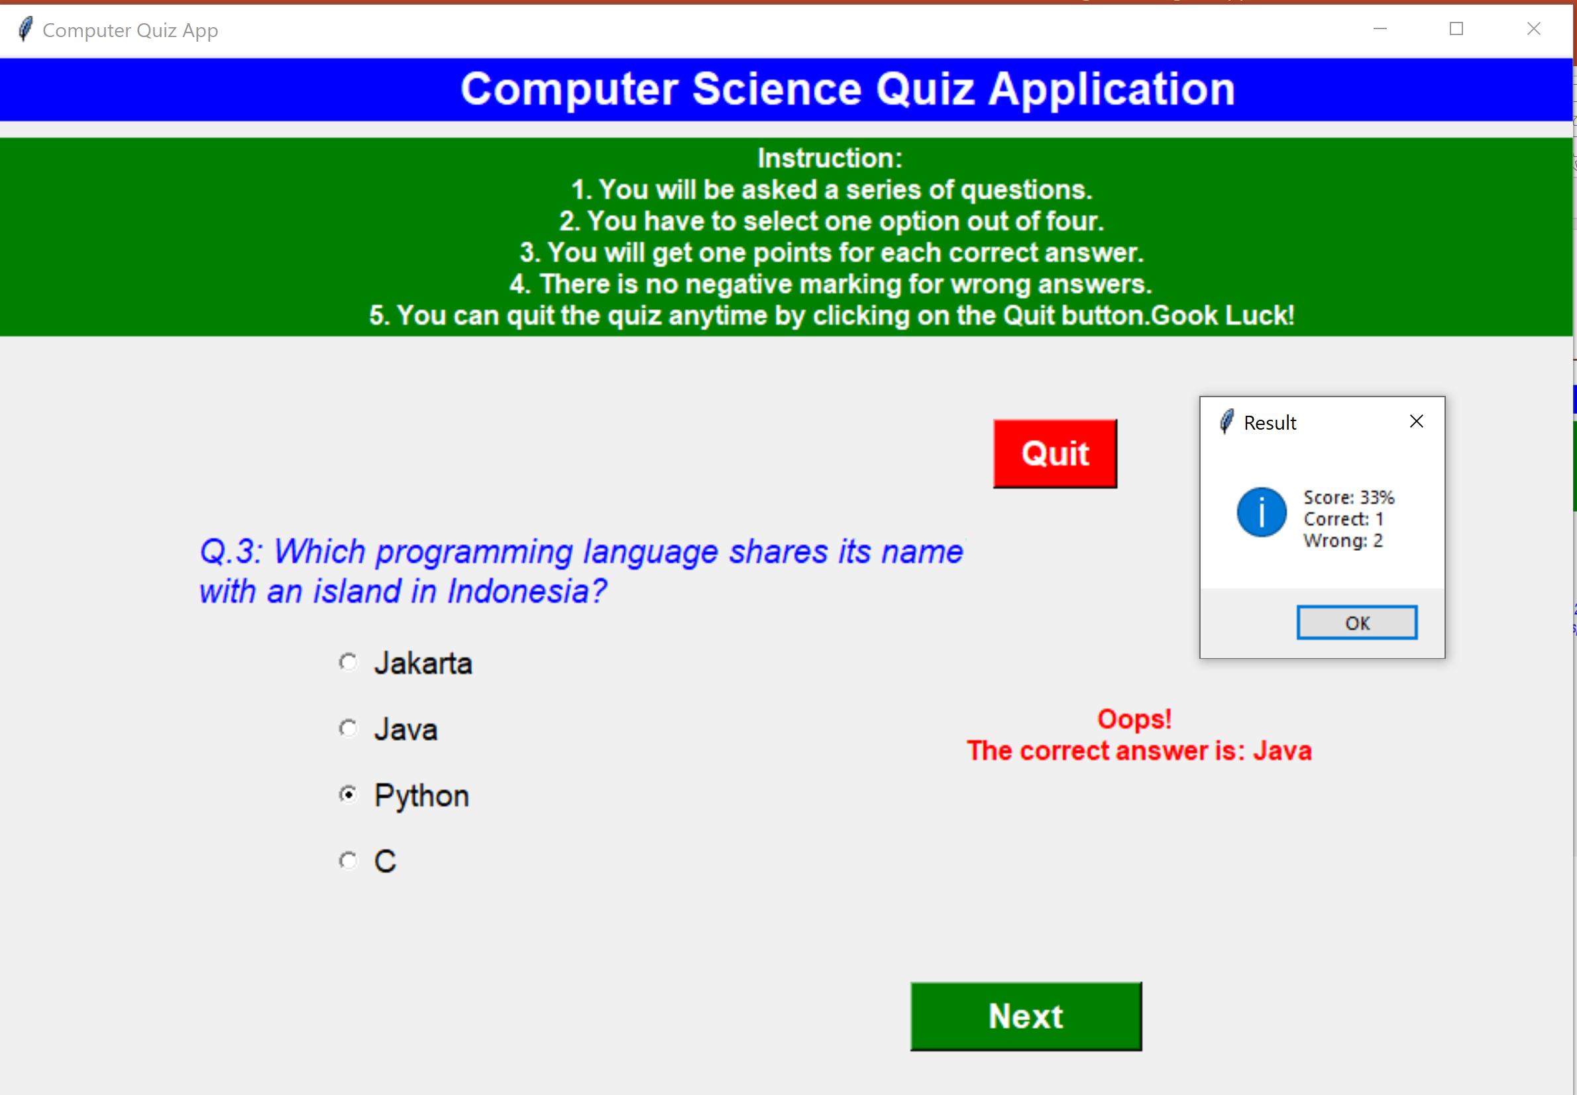

Slide 13

Summary
Overall this quiz game is a fun and interactive way to test your knowledge on a particular topic.

Slide 14
Github link for this project
subramanikavitha/Python-Project: QUIZ game project (github.com)

Slide 15


Thank you
Contact:
Kavitha Subramani​
kavithankl@hotmail.com

Slide 16
References
Python - MCQ Quiz Game using Tkinter - GeeksforGeeks
Python Tkinter Quiz - Complete Tutorial - Python Guides

